Slide 1
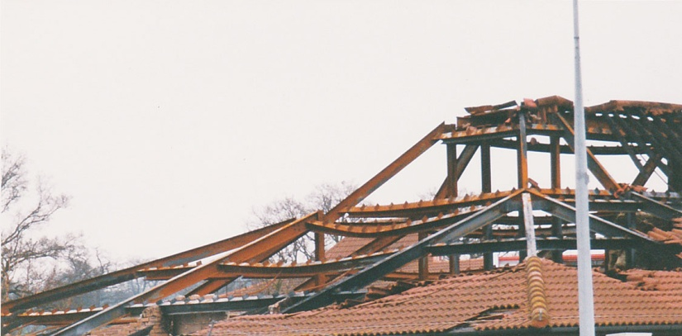
FIGURE 40.1 Steel Frame After a Fire
Copyright © 2016 Elsevier Ltd. All rights reserved.

